Slide 1

D-1 100분만에 배워보는 Windows Universal App 개발
김영욱 Evangelist
Yowkim@Microsoft.com

Slide 2
7. SQLite Local Database
8. Toast
UWP
XAML Controls
Networking
Linq
Adaptive UI
Data Binding

Slide 3

Introducing the UWP

Slide 4
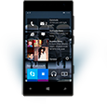

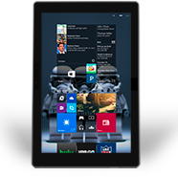
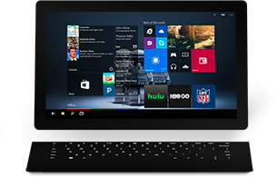

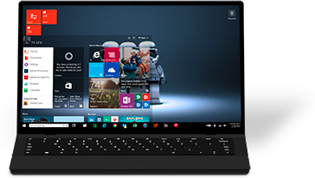

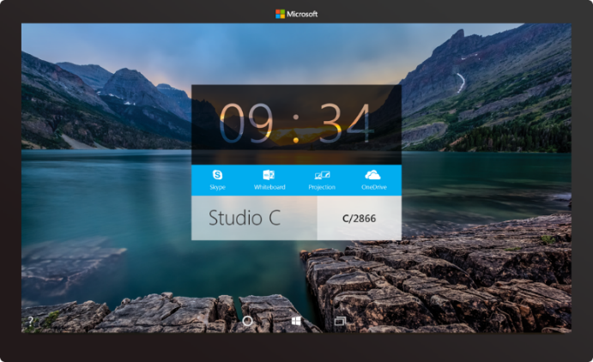

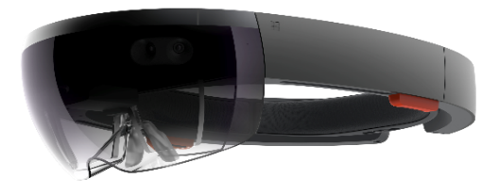
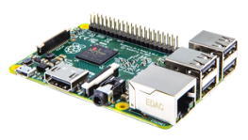

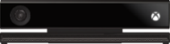
2-in-1s (Tablet or Laptop)
Classic Laptop
Desktops & All-in-Ones
Phone
Phablet
Small Tablet
Large Tablet
Windows 10
Surface Hub
Xbox
Holographic
IoT

Slide 5
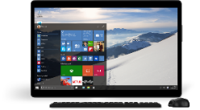
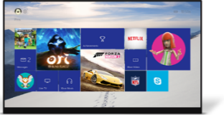
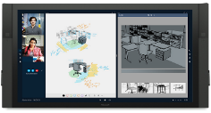
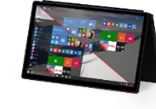
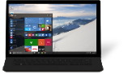
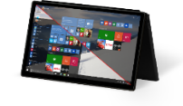
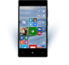
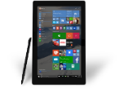
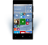











PC
XBox
Mobile
Surface Hub
Devices +IoT
HoloLens
Universal Windows Apps
Multiple device families
Adaptive User Interface
Reuse Existing Code
Natural User Inputs
One Store + One Dev Center
One SDK + Tooling
One Universal Windows Platform

Slide 6
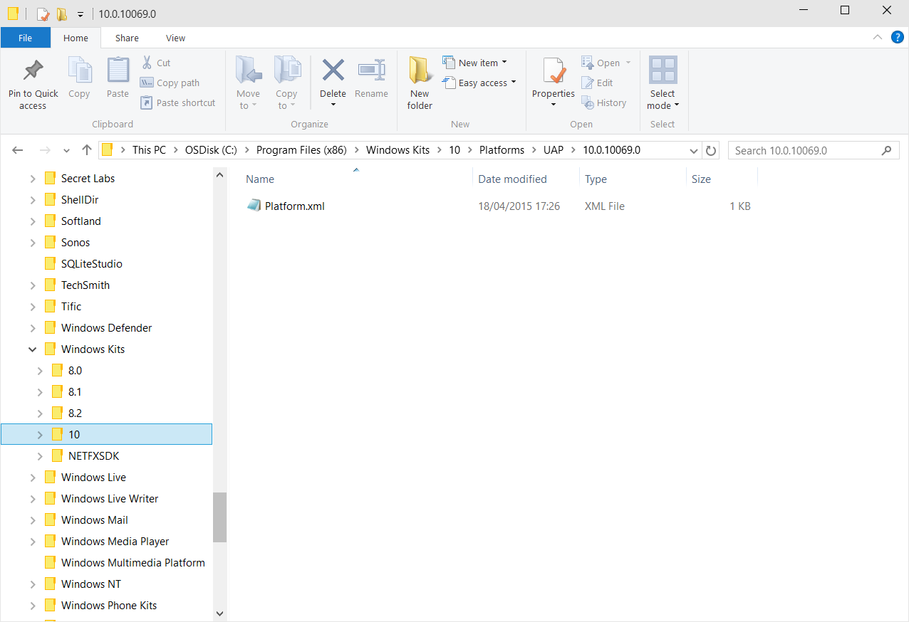
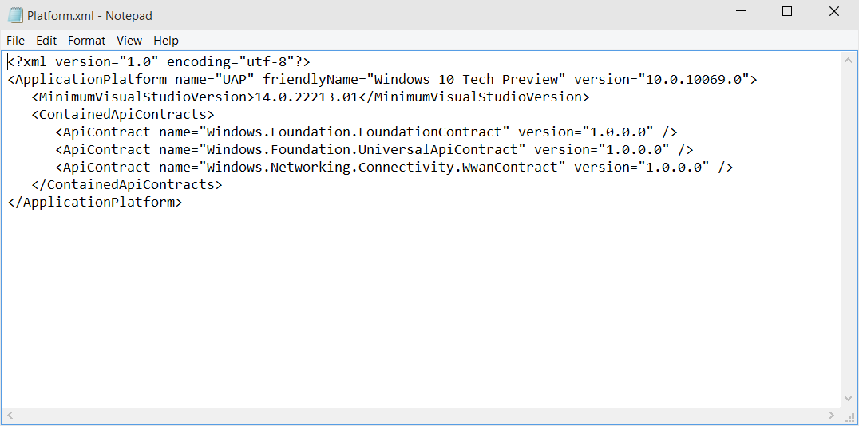
Universal Windows Platform
A single API surface
A guaranteed API surface
The same on all devices
Universal Windows Platform
Windows Core
Desktop
Device
Phone
Device
Xbox
Device

Slide 7
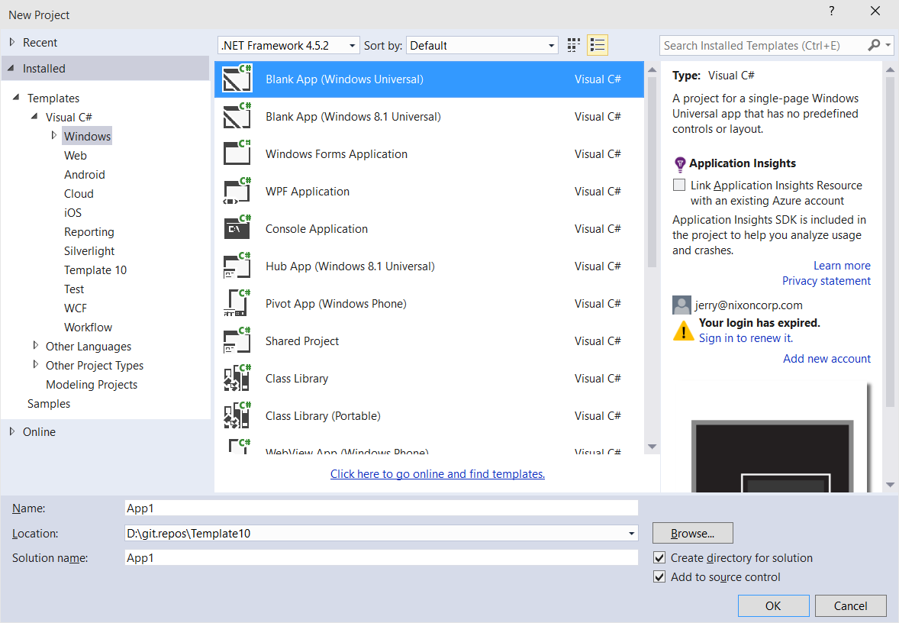
Windows app
A single binary
Running on any device
Testing for capabilities
Adjusting to devices
Windows App
Universal Windows Platform
Windows Core
Desktop
Device
Phone
Device
Xbox
Device

Slide 8
Hello devices
2:05

Slide 9
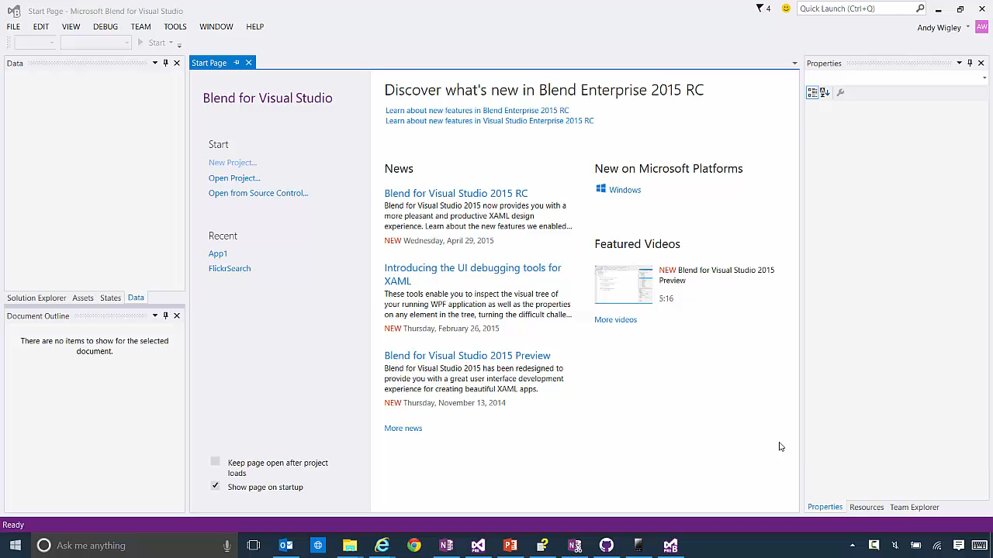

Slide 10
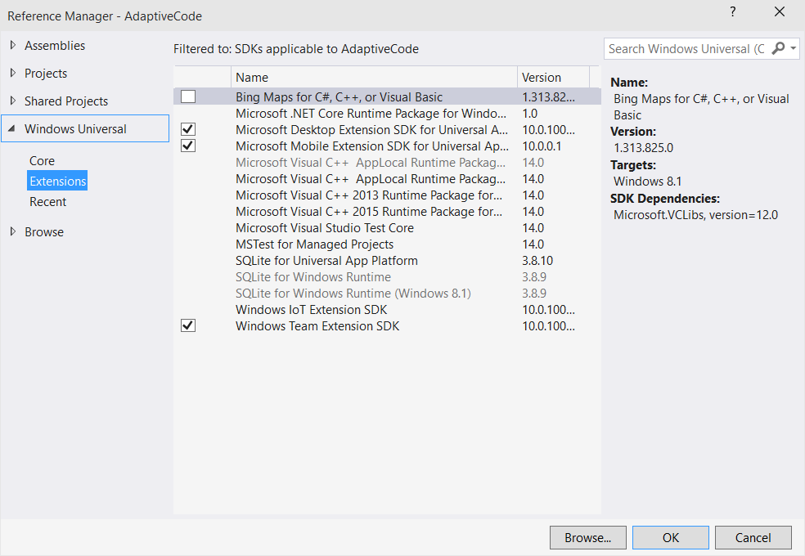
Platform extensions
Device-specific API
Family-specific capabilities
Compatible across devices
Unique update cadence
Windows App
Desktop
extension
Phone
extension
Xbox
extension
Universal Windows Platform
Windows Core
Desktop
Device
Phone
Device
Xbox
Device

Slide 11
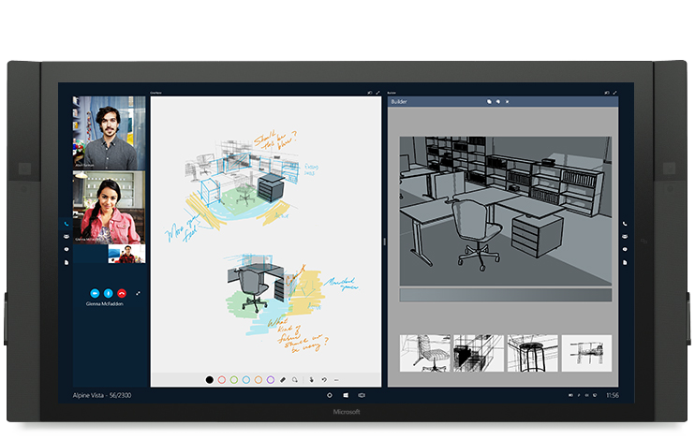
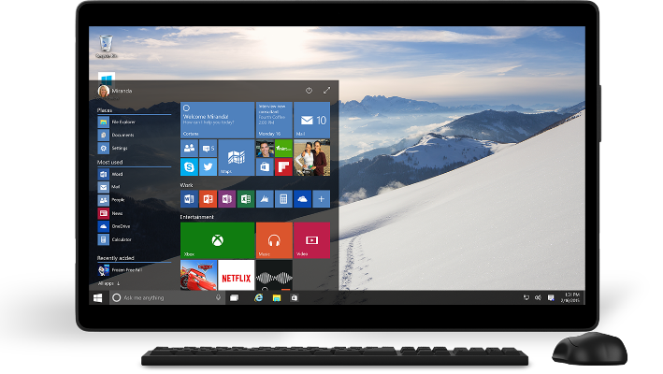
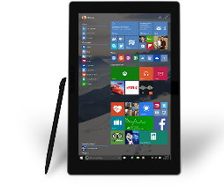

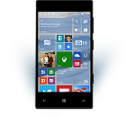
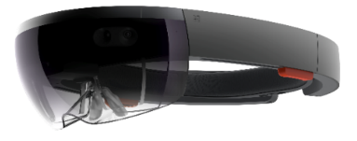
Universal Windows Platform
One Operating System
One Windows core for all devices
One App Platform
Apps run across every family
One Dev Center
Single submission flow and dashboard
One Store
Global reach, local monetization Consumers, Business & Education

Slide 12
WPF
WF
MFC
XAML
HTML
Bridging technologies
Obj.C
iOS
Java
Android
Web
hosted
Win32
desktop
DirectX
.Net
languages
C++
.Net
languages
C++
& CX
WWA
.Net
runtime
Universal Windows Platform
Windows 10
operating system

Slide 13
Let’s talk about bridge technologies
Objective-C
At Build we announced iOS code can be reused in a Windows app
Android
At Build we announced Android code can be reused in a Windows app to run on Windows Phone
Web
At Build we announced web sites can be wrapped to run on Windows
Win32
At Build we announced that Classic Windows Apps (CWA) can be packaged as an Appx

Slide 14
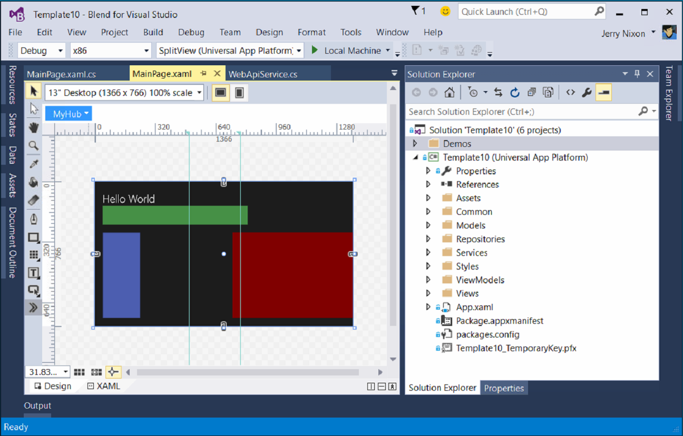
Blend for Visual Studio
The XAML Developer’s IDE
Always part of Visual Studio
Uses the Visual Studio shell
Full auto-complete & intellisense
Validation
Snippets
Peek
File & solution management
Resource management
Data management
Animation
States

Slide 15
Visual Studio 2015 Editions
Enterprise
Architecture Modeling, Diagnostics, VSO/ALM & Release Management
Professional
Architecture Validation, VSO/ALM & Feedback Management
Community Editions
Visual Studio Professional Edition

Slide 16
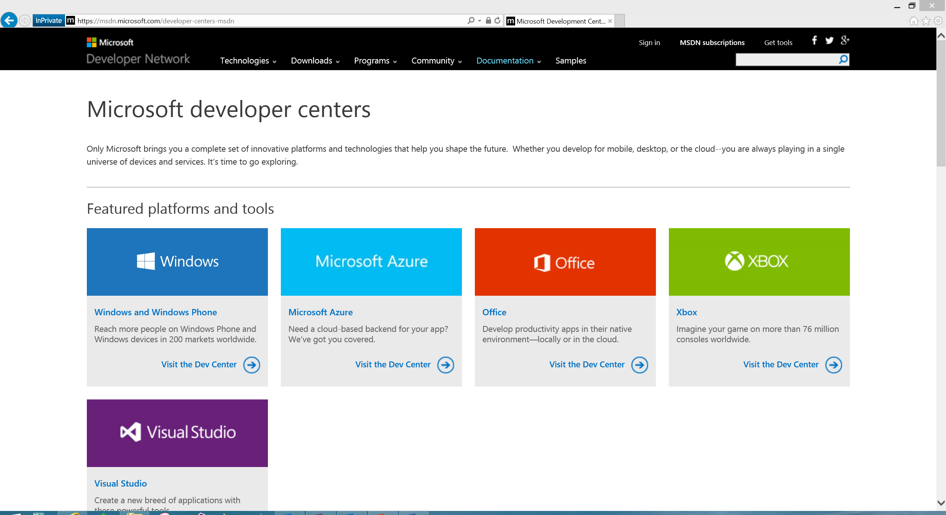
Microsoft Developer Network
Microsoft documentation
http://msdn.Microsoft.com
http://dev.Windows.com
Microsoft training
http://msevents.Microsoft.com
http://MicrosoftVirtualAcademy.com
MSDN Subscription
Operating Systems
Server/Client Products
Developer Tools
Azure/O365 Credits

Slide 17
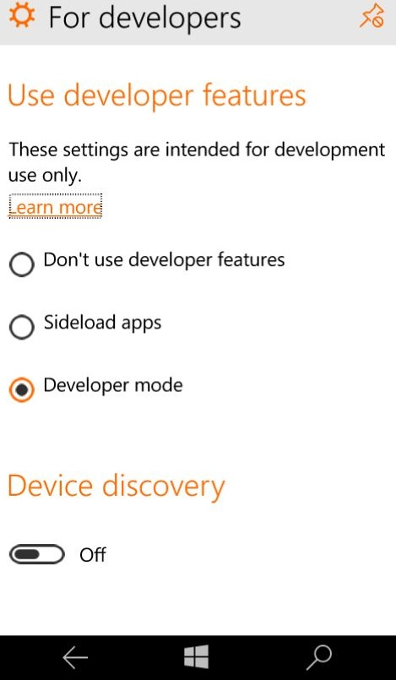
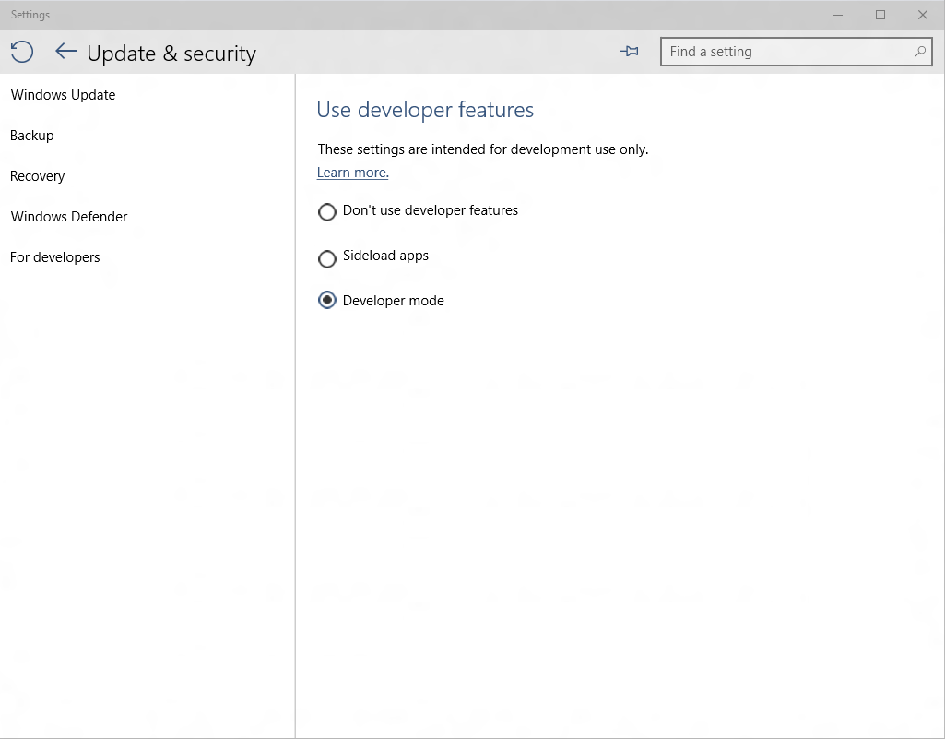
Developer unlock

Slide 18
XAML controls

Slide 19
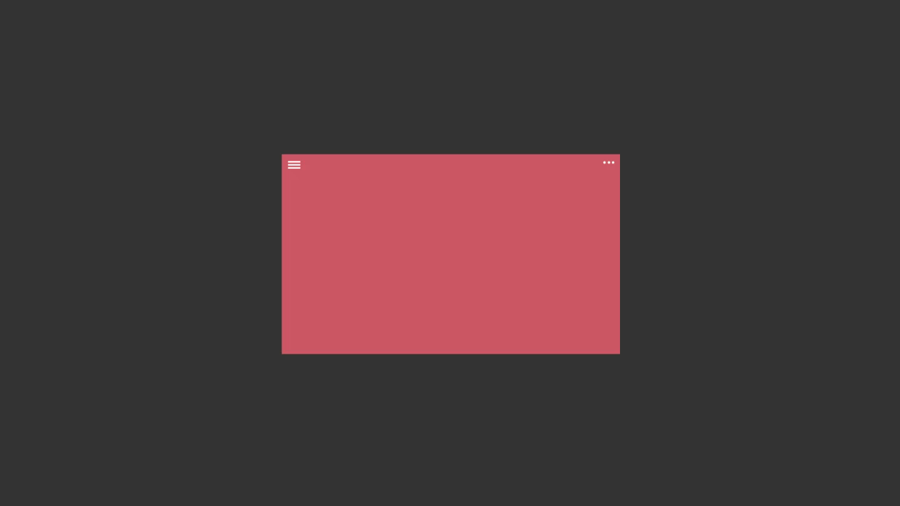
Layout controls
<Border Thickness="" Brush="" />
<Canvas />
<Grid />
<RelativePanel />
<ScrollViewer />
<SplitView DisplayMode="" />
<StackPanel Orientation="" />
<VariableSizedWrapGrid />
<ViewBox Stretch="" />

Slide 20
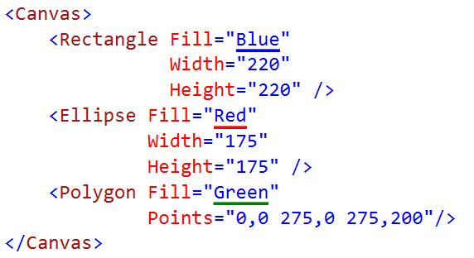
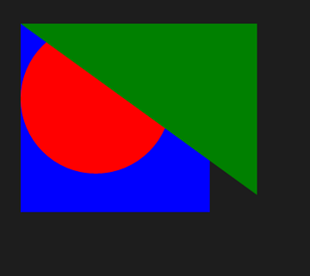
Canvas

Slide 21
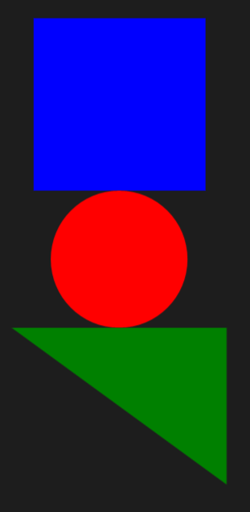
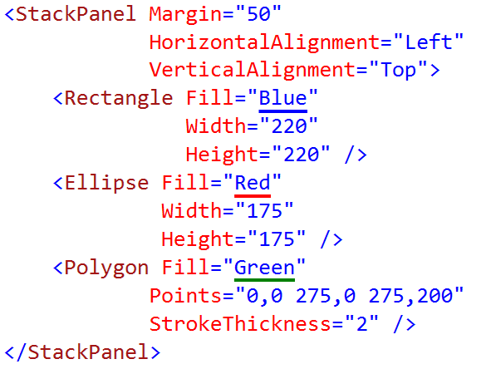
StackPanel

Slide 22
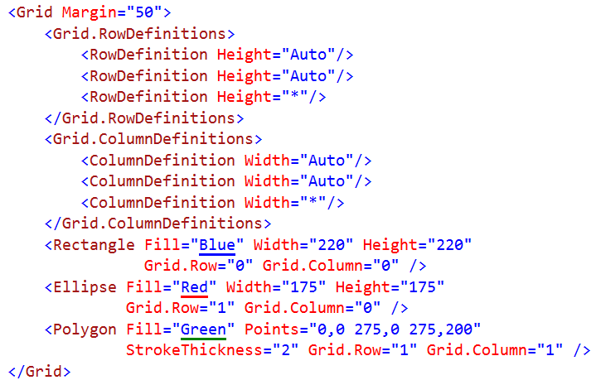
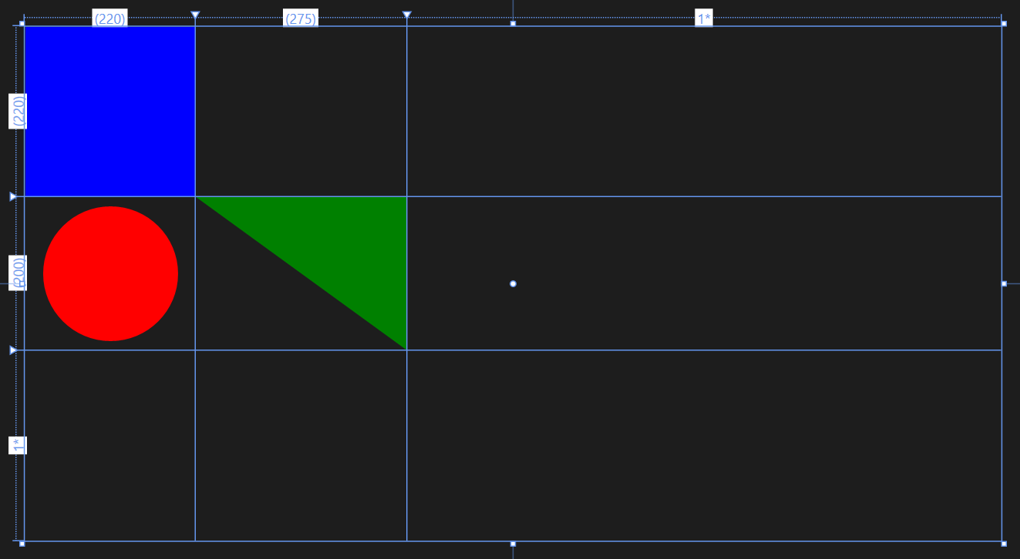
Grid

Slide 23
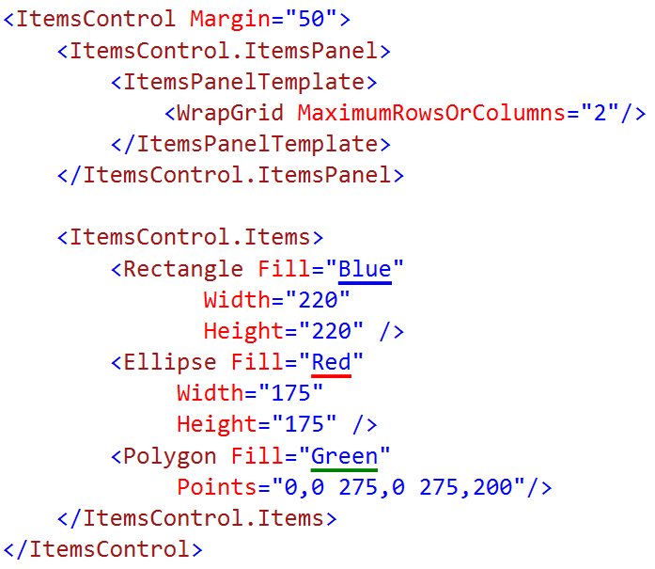
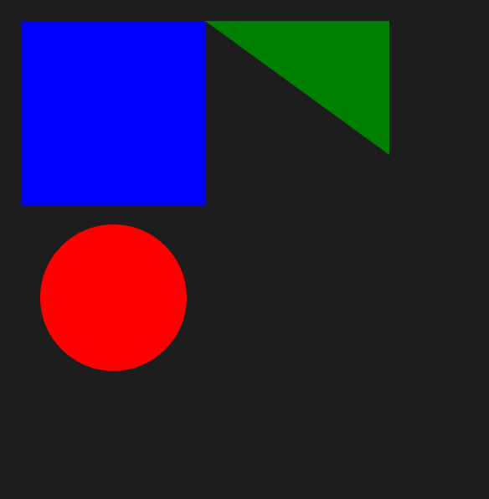
WrapGrid

Slide 24
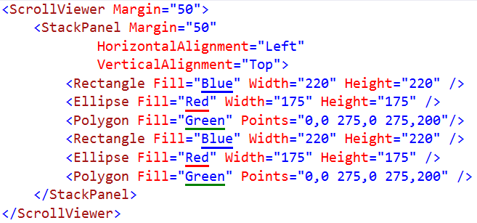
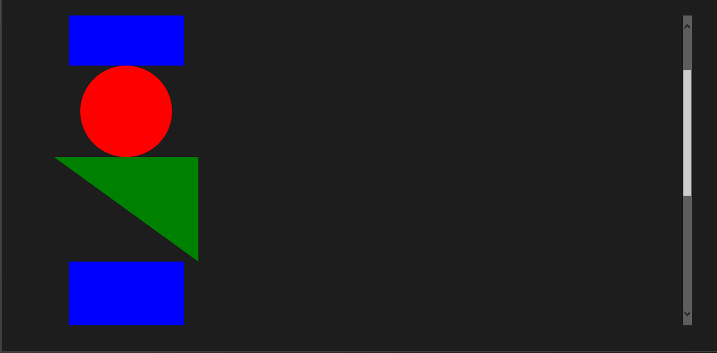
ScrollViewer

Slide 25
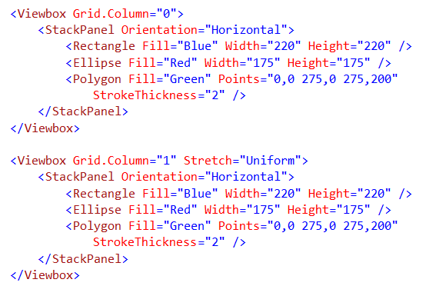
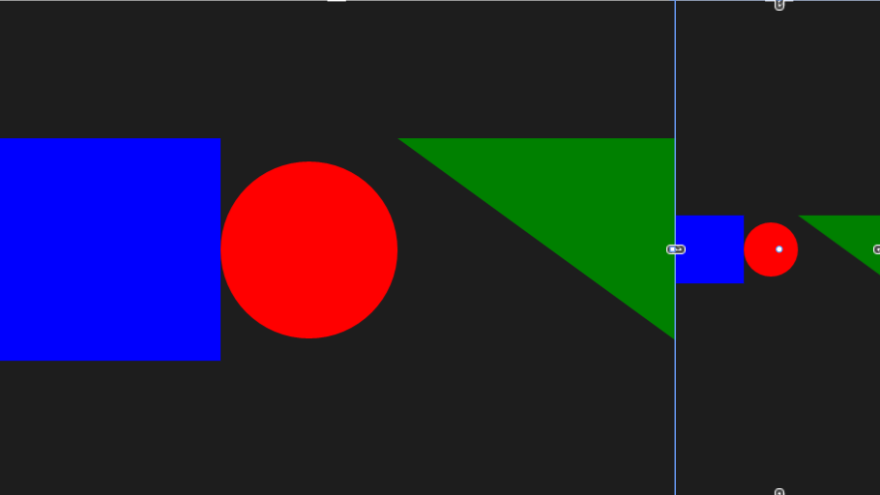
Viewbox

Slide 26
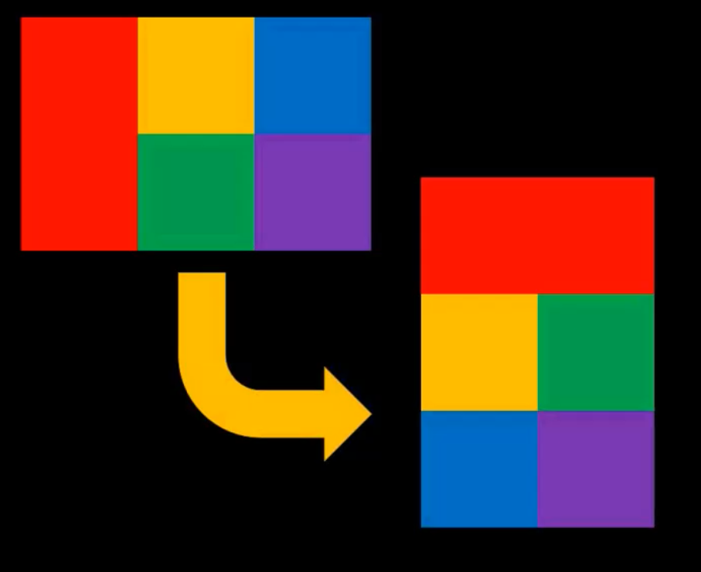
RelativePanel
Some child elements act as anchors
Most child elements relate to others
It's a layout technique friendly with States

Slide 27
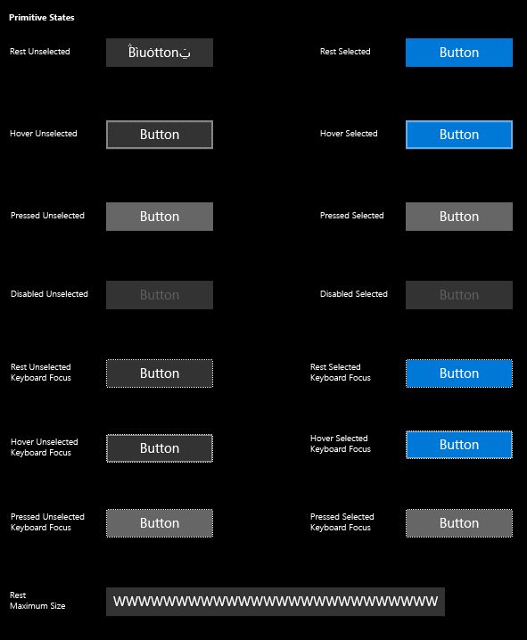
Buttons
<Button Content="" />
<HyperlinkButton />
<RepeatButton />
<ToggleButton IsChecked="" />

Slide 28
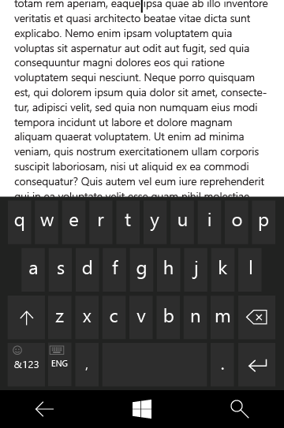
Text controls
<TextBox Text="" />
<PasswordBox Text="" />
<TextBlock Text="" />
<RichEditBox Content="" />
<RichTextBlock Content="" />
<BitmapIcon UriSource="" />
<FontIcon Glyph="" />
<SymbolIcon Icon="" />
<PathIcon Data="" />

Slide 29
SplitView
 | IsPaneOpen="True" | IsPaneOpen="False"
DisplayMode= "Inline"
DisplayMode= "Overlay"
DisplayMode= "CompactInline"
DisplayMode= "CompactOverlay"

Slide 30
SplitView
2:05

Slide 31
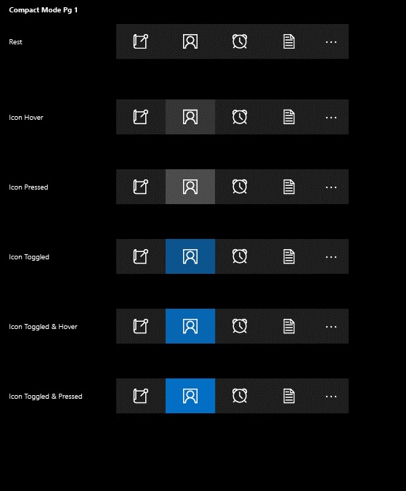
App bars and commands
<AppBar />
<CommandBar />
<AppBarButton Label="" Icon="" />
<AppBarToggleButton IsChecked="" />
<AppBarSeparator />

Slide 32
AppBar
2:05

Slide 33
Networking

Slide 34
Daum 검색 API http://developers.daum.net/

Slide 35
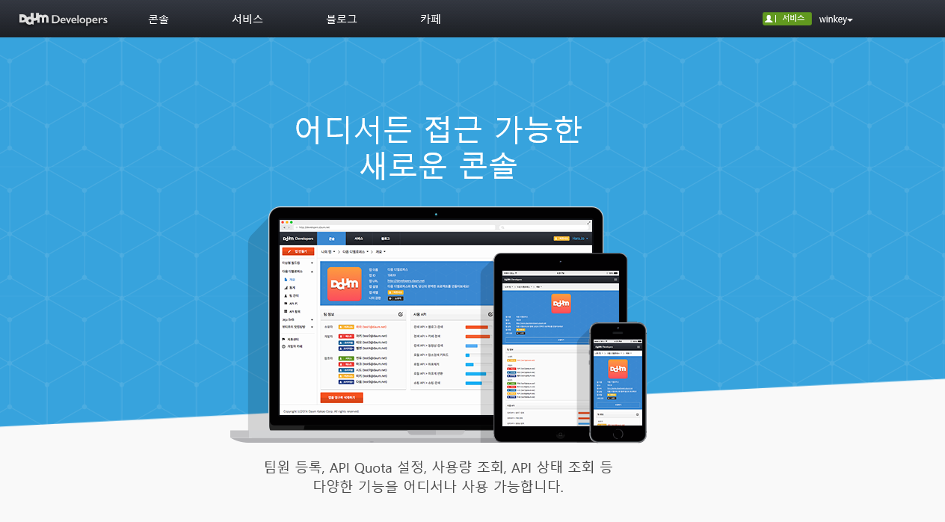
Daum Open APIs

Slide 36
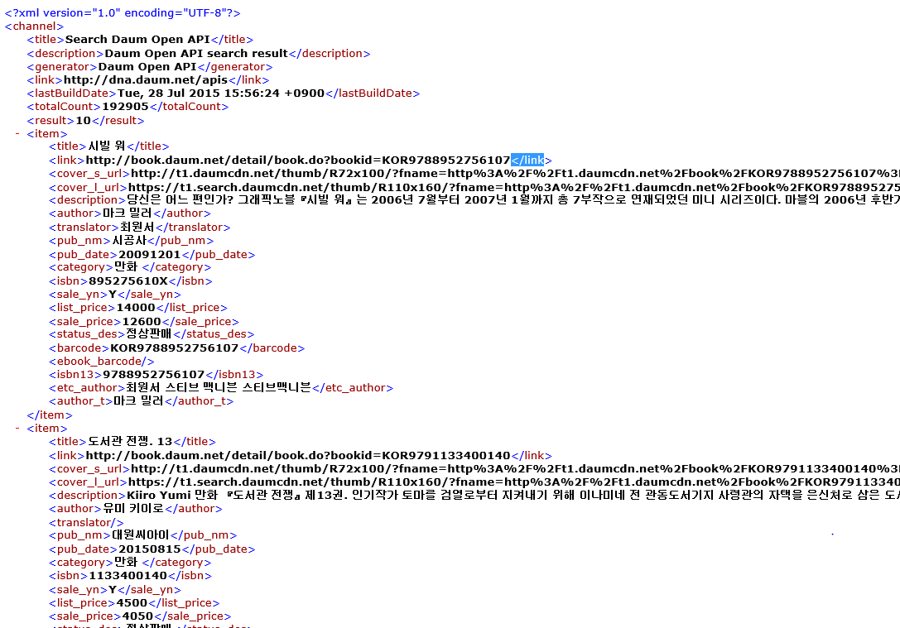
Daum Open APIs

Slide 37

System.Net.Http.HttpClient
Namespace: System.Net.Http.HttpClient Assembly: System.Net.Http (in System.Net.Http.dll)

Slide 38
System.Net.Http.HttpClient

Slide 39
Entity Class
class BookItem
{ public Int64 Id { get; set; } public string Title { get; set; } public string Category { get; set; } public string ImageUrl { get; set; } public string Description { get; set; } }

Slide 40
Linq

Slide 41

System.Net.Http.HttpClient

Slide 42
Linq

Slide 43
Adaptive UI

Slide 44


Slide 45


Slide 46




Adaptive design
Tablet (landscape) / Desktop
Phone (portrait)

Slide 47


Slide 48


Tailored design
Tablet (landscape) / Desktop
Phone (portrait)

Slide 49
Tailored design
Build pages/code for individual families
Use MRT in App.xaml.cs to determine the family
One-handed interface?
Typically phone or small tablets
Test diagonal screen size (<7")
if (physical_diagonal_size <= 7)
// optimized for one-handed operation
rootFrame.Navigate(typeof(MainPage_OneHanded), e.Arguments);
else
rootFrame.Navigate(typeof(MainPage), e.Arguments);

Slide 50
Visual States
Define XAML views
Unique layout for distinct states
Simplify animation
Automatically implement state transitions
Build in Blend
Design and preview states and transitions

Slide 51


Slide 52
Visual states

Slide 53
How to set the visual state
VisualStateManager.Goto(element, state, transition)
public MainPage()
{
this.InitializeComponent();
this.SizeChanged += (s, e) =>
{
var state = "VisualState000min";
if (e.NewSize.Width > 500)
state = "VisualState500min";
else if (e.NewSize.Width > 800)
state = "VisualState800min";
else if (e.NewSize.Width > 1000)
state = "VisualState1000min";
VisualStateManager.GoToState(this, state, true);
};
}

Slide 54
Adaptive triggers

Slide 55
Data binding

Slide 56

Data binding basics

Slide 57


Dynamic Data
Use data binding to connect to a data source
Typical data source would be a view model

Slide 58
Data Binding

Slide 59
SQLite Local Database

Slide 60

SQLite.org
Documentation
SQL Syntax
C/C++ API Reference
Source and tools download

Slide 61
Choice of .NET APIs
SQLitePCL SQL statements Thin wrapper around the SQLite C API
SQLite-NET
LINQ syntax Lightweight ORM
var db = new SQLite.SQLiteAsyncConnection(App.DBPath);
var _customer = await (from c in db.Table<Customer>() where c.Id == customerId select c).FirstOrDefaultAsync(); if (customer != null) { var Id = _customer.Id; var Name = _customer.Name; }
using (var conn = new SQLiteConnection("demo.db")) { Customer customer = null;
using (var statement = conn.Prepare( "SELECT Id, Name FROM Customer WHERE Id = ?"))
{
statement.Bind(1, customerId);
if (SQLiteResult.DONE == statement.Step()) {
customer = new Customer() {
Id = (long)statement[0],
Name = (string)statement[1] };
}
}
}
…and others!

Slide 62

Installing SQLitePCL to your Solution

Slide 63
SQLitePCL

Slide 64
Create database and tables
private void LoadDatabase() { // Get a reference to the SQLite database conn = new SQLiteConnection("sqlitepcldemo.db"); string sql = @"CREATE TABLE IF NOT EXISTS Customer (Id INTEGER PRIMARY KEY AUTOINCREMENT NOT NULL, Name VARCHAR( 140 ), City VARCHAR( 140 ), Contact VARCHAR( 140 ) );"; using (var statement = conn.Prepare(sql)) { statement.Step(); } }

Slide 65
Insert
// SqlConnection was opened in App.xaml.cs and exposed through property conn var db = App.conn; try { using (var custstmt = db.Prepare("INSERT INTO Customer (Name, City, Contact) VALUES (?, ?, ?)")) { custstmt.Bind(1, customerName); custstmt.Bind(2, customerCity); custstmt.Bind(3, customerContact); custstmt.Step(); } } catch (Exception ex) { // TODO: Handle error }

Slide 66
Select
public Customer GetCustomer(int customerId) { Customer customer = null; using (var statement = dbconn.Prepare("SELECT Id, Name, City, Contact FROM Customer WHERE Id = ?")) { statement.Bind(1, customerId); if (SQLiteResult.DONE == statement.Step()) { customer = new Customer() { Id = (long)statement[0], Name = (string)statement[1], City = (string)statement[2], Contact = (string)statement[3] }; } } return customer; }

Slide 67
Update
// See if the customer already exists var existingCustomer = GetCustomer(customer.Id); if (existingCustomer != null) { using (var custstmt = dbconn.Prepare("UPDATE Customer SET Name = ?, City = ?, Contact = ? WHERE Id=?")) { // NOTE when using anonymous parameters the first has an index of 1, not 0. custstmt.Bind(1, customer.Name); custstmt.Bind(2, customer.City); custstmt.Bind(3, customer.Contact); custstmt.Bind(4, customer.Id); custstmt.Step(); } }

Slide 68
Delete
public void DeleteCustomer(int customerId) { using (var statement = dbconn.Prepare("DELETE FROM Customer WHERE Id = ?")) { statement.Bind(1, customerId); statement.Step(); } }

Slide 69
SQLite using SQLitePCL

Slide 70
Toast

Slide 71


Toasts
Glance (consume)
See new information from your apps.
Act (chase, or take actions)
Toasts invite you to begin or complete a task.
The toast is the app’s door by chasing (clicking) it.
Additional actions enable users to perform simple tasks without context switching.

Slide 72


Toast templates
If a template meets your needs, go ahead and use it.
Previous templates remain
Phone and Windows templates have been merged
Adaptive template
Same XML syntax as tiles

Slide 73
Sending toast
Scheduled
Set template and time with “ScheduledToastNotification”
Toast can also be set to be recurring.
Local
Send from (foreground/background) app
This includes desktop apps with “AppUserModelID”
Push
Use push services

Slide 74






Interactive toast
Desktop
Mobile

Slide 75
A Developer’s Guide to Windows 10 Preview http://www.microsoftvirtualacademy.com/training-courses/a-developers-guide-to-windows-10-preview

